Slide 1

AirNB : Airlytics–Smart Stay Data Insights
Girija G
INTERNSHIP_17546440516895be537820f

Slide 2

PROBLEM STATEMENT
Airbnb guests and hosts face uncertainties in pricing and booking quality
Need for actionable insights to optimize rentals and bookings
Understand host credibility, pricing trends, cancellation policies, and guest expectations

Slide 3
Project Description
Analyzed comprehensive Airbnb dataset for NYC neighborhoods
Cleaned and preprocessed listing data
Visualized pricing, reviews, host verification, and cancellation impact
Performed textual analysis of house rules
Delivered data-driven recommendations for hosts and guests

Slide 4

WHO ARE THE END USERS?
Airbnb Hosts: Optimize listing pricing and appeal
Guests: Make informed stay decisions
Airbnb Platform Analysts: Improve rental experience
Data Scientists and Researchers: Study real-world hospitality data

Slide 5

Technology Used
Python (Pandas, NumPy) for data processing
Matplotlib & Seaborn for visualization
WordCloud for text analysis
Jupyter Notebook for interactive exploration

Slide 6
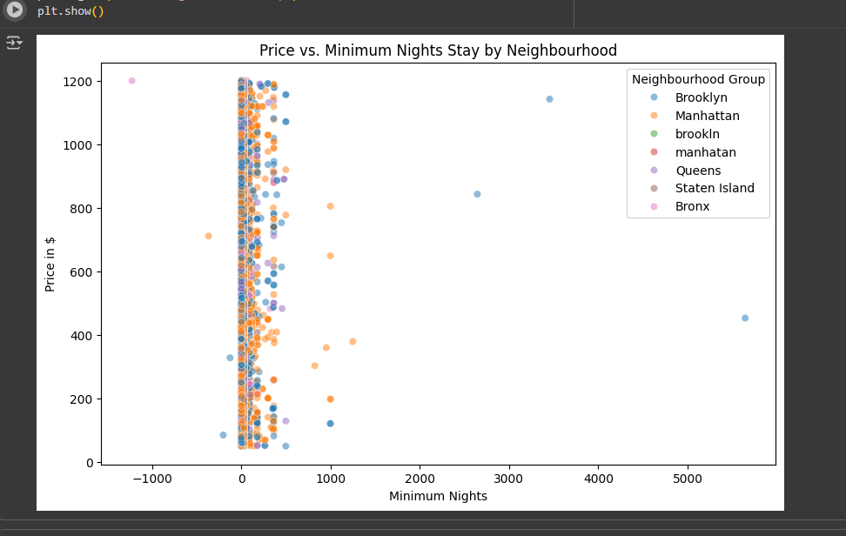
RESULTS1
Demo Link

Slide 7
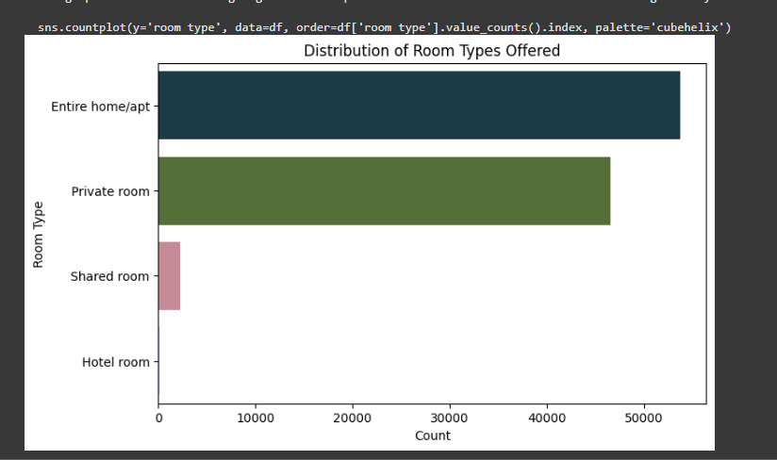
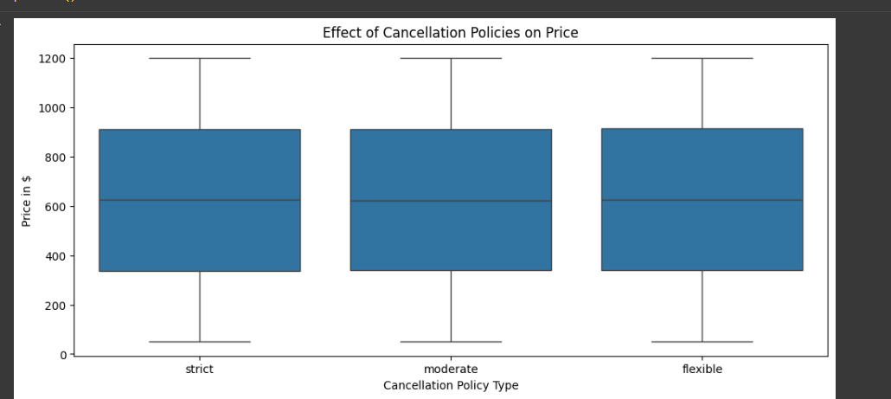
RESULTS2
[Add screen shots of your code or Chart(s) ]
Demo Link

Slide 8
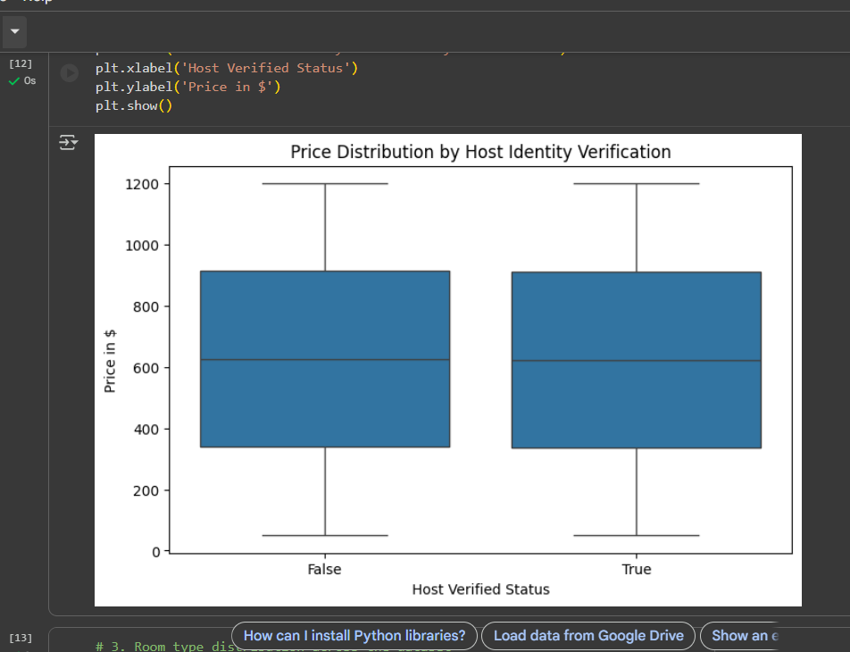
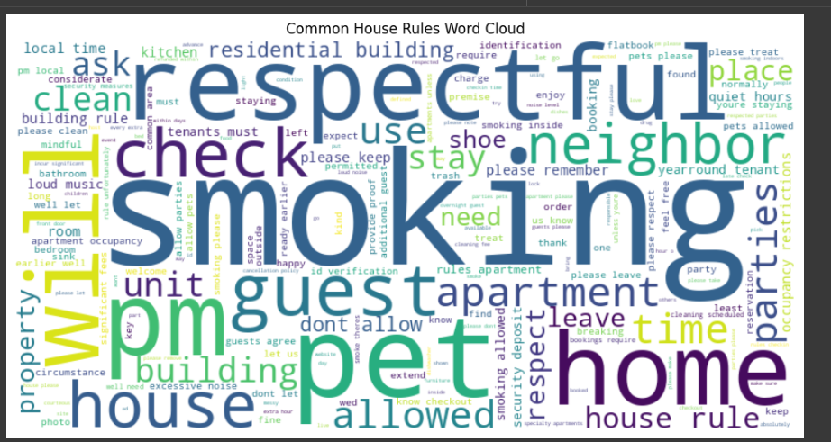
RESULTS3
Visualizing guest expectations
Demo Link

Slide 9
GitHub repository
https://github.com/girijageddavalasa/VOIS_AICTE_Oct2025_GirijaG
Demo Link

Slide 10
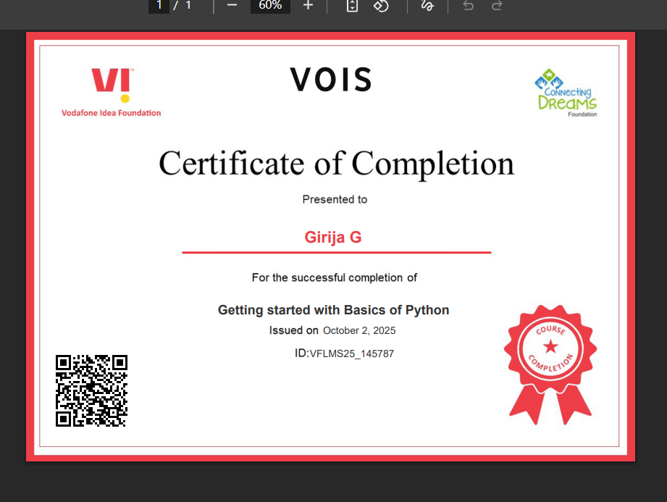
Getting started with Basics of Python Certificate

Slide 11
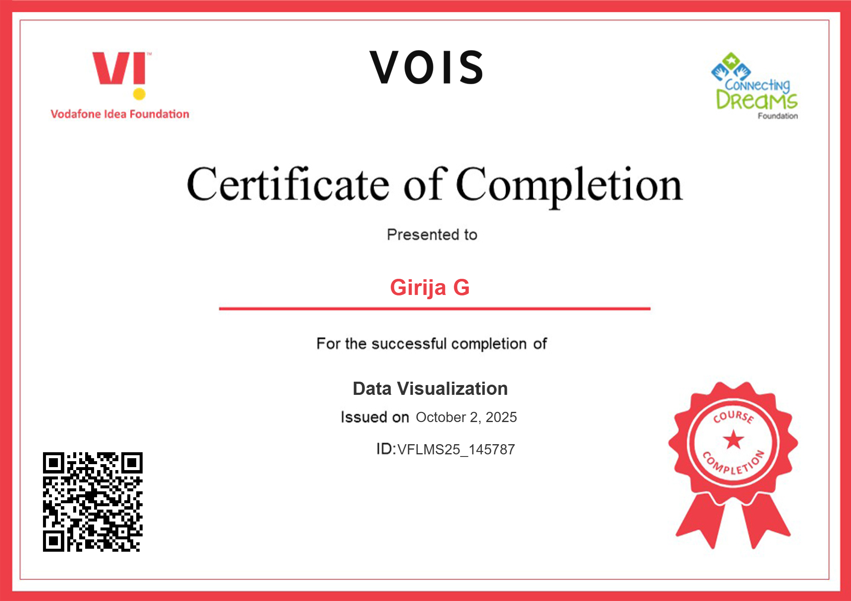
Data Visualization Certificate

Slide 12
Thank you
.
.

